Slide 1

Ho Chi Minh City University of Transport
Image Processing and Computer Vision
Line Detection
Tran Le Anh
anhtl@ut.edu.vn
04-2025

Slide 2
Line Detection
Hough Transform

Slide 3
Line Detection
Hough Transform

Slide 4
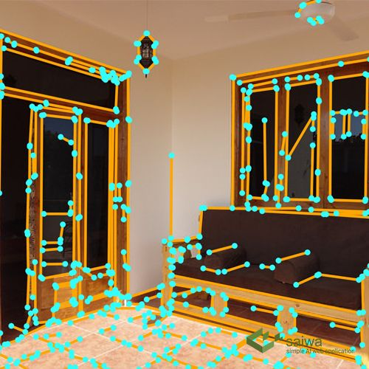
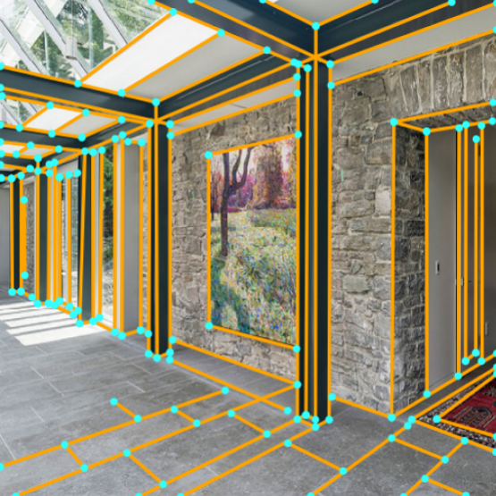
Line Detection
Concept
- In image processing, line detection is an algorithm that takes a collection of n edge points and finds all the lines on which these edge points lie.

Slide 5
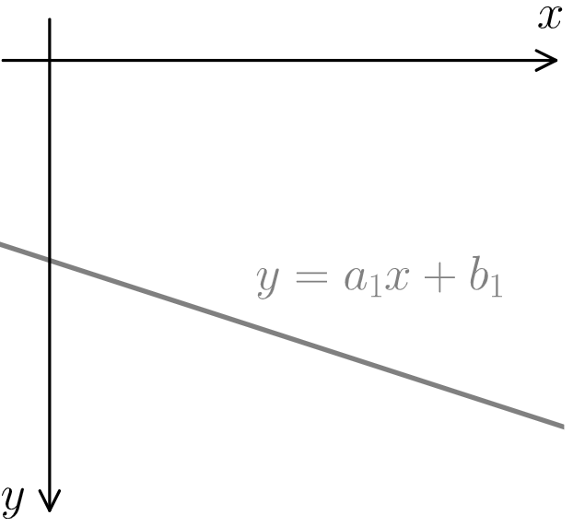
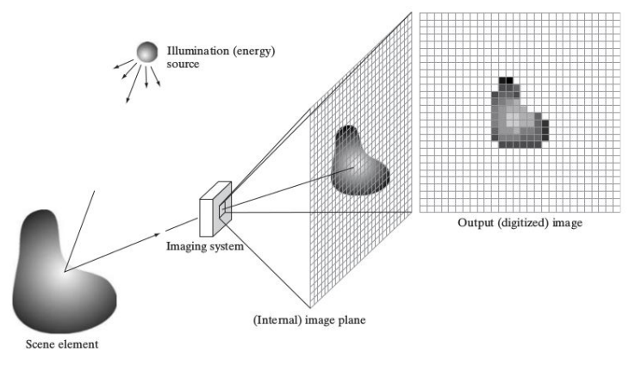
Line Detection
Parameterization

Slide 6
Line Detection
Techniques
- Hough transform
- Convolution-based techniques
- Deep learning approaches
Ref: https://en.wikipedia.org/wiki/Line_detection

Slide 7
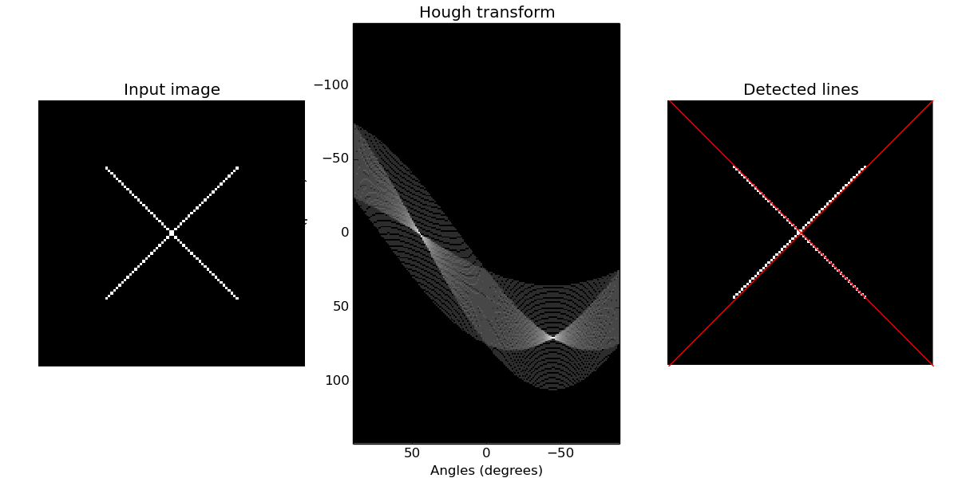
Line Detection
Hough Transform
- The Hough transform is a feature extraction technique in image processing used to detect shapes, particularly lines, circles, and other curves, by transforming the image from the image space to a parameter space.
Ref: Straight line Hough transform

Slide 8


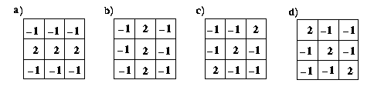

Line Detection
Convolution-based Techniques
- The line detection operator consists of a convolution kernel tuned to detect the presence of lines of a particular width n, at a particular orientation θ.
image
horizontal kernel
45 degree kernel
Four line detection kernels which respond maximally to horizontal, vertical and oblique (+45 and - 45 degree) single pixel wide lines.
Ref: https://homepages.inf.ed.ac.uk/rbf/HIPR2/linedet.htm

Slide 9
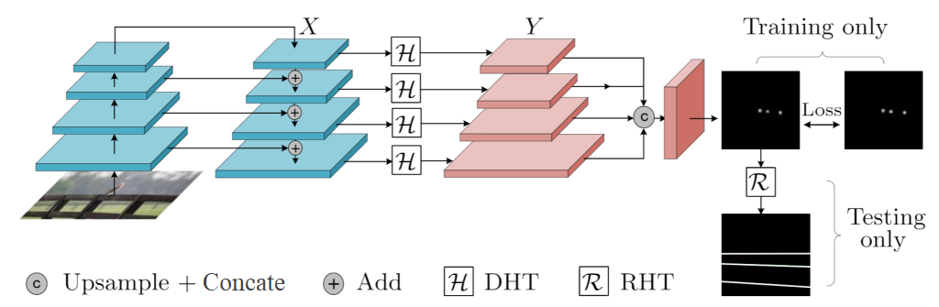
Line Detection
Deep Learning Approaches
- Deep Hough Transform (DHT) for semantic line detection is a method that integrates the classical Hough Transform with deep learning to detect meaningful line structures in images.
Ref: Deep Hough Transform for Semantic Line Detection

Slide 10
Line Detection
Applications
- Autonomous driving
- Automatic parking
- Scene analysis

Slide 11
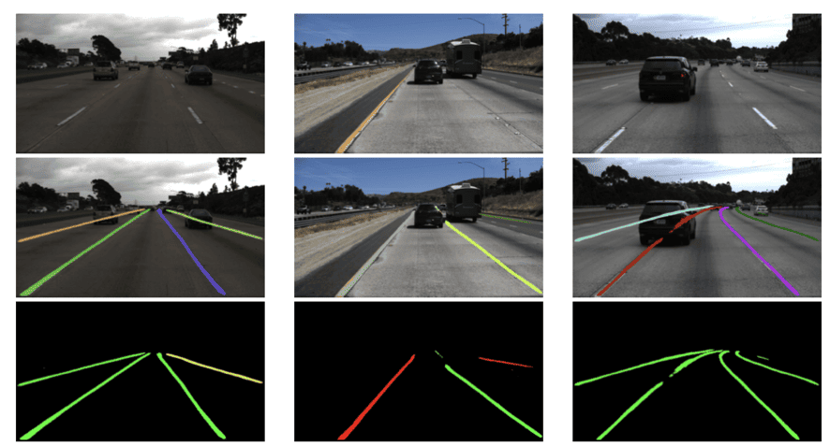
Line Detection
Autonomous Driving
- Lane line detection is crucial for driver assistance systems and self-driving cars, helping them navigate and avoid obstacles.
Ref: https://www.thinkautonomous.ai/blog/lane-detection/

Slide 12
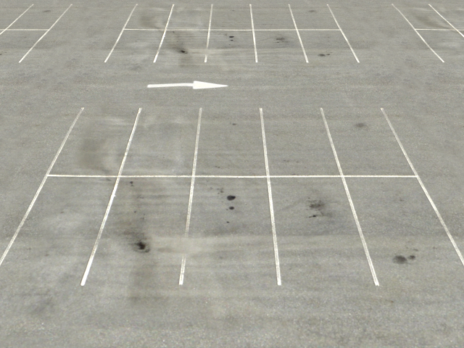
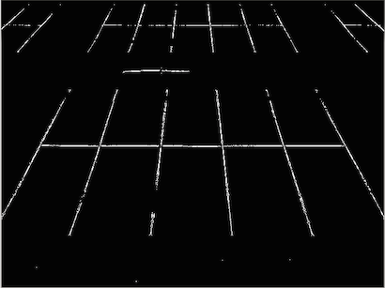
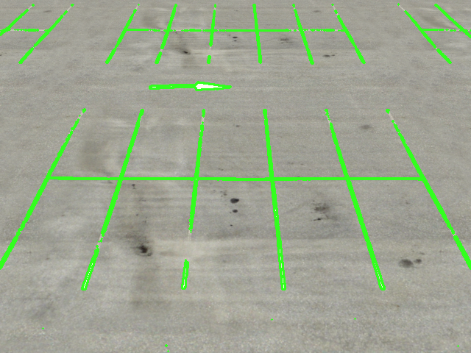
Line Detection
Automatic Parking
- Automatic parking is an autonomous car-maneuvering system that moves a vehicle from a traffic lane into a parking spot to perform parallel, perpendicular, or angle parking.
image
mask
lines
Ref: https://stackoverflow.com/questions/45322630/how-to-detect-lines-in-opencv

Slide 13
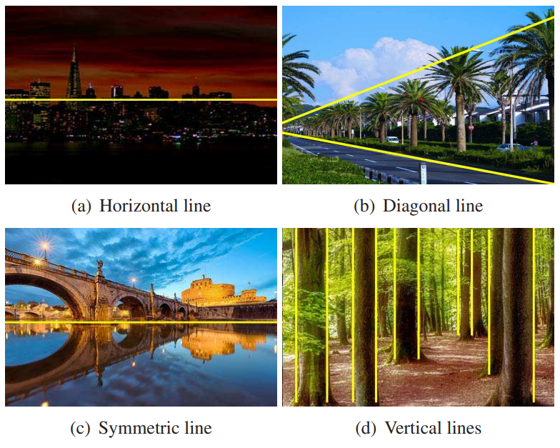
Line Detection
Scene Analysis
- Line detection can be used for horizon estimation, composition enhancement, and image simplification, which are key feature in many visual tasks.
Ref: Semantic Line Detection and Its Applications

Slide 14
Line Detection
Hough Transform

Slide 15
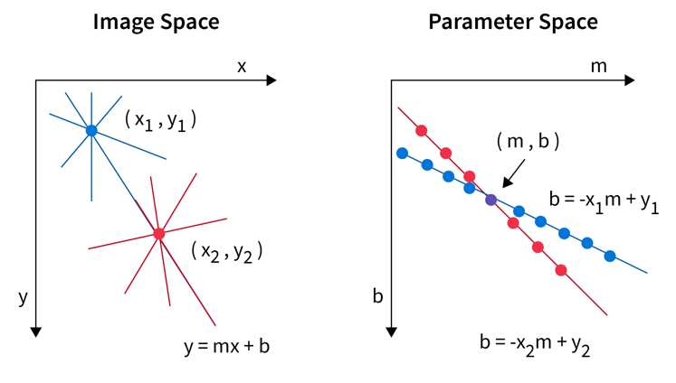
Hough Transform
Concept
- The Hough transform transposes the image from the spatial space to another space, where the information of interest is represented differently: the lines in the spatial space are transformed into points in the Hough space.
Ref: https://www.scaler.com/topics/hough-transform-in-image-processing/

Slide 16
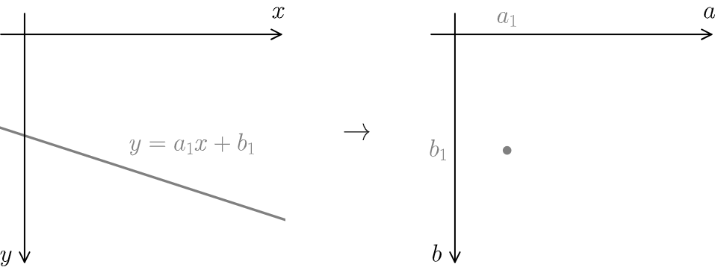
Hough Transform
Hough’s Idea
- In the spatial space (x,y), a line is parameterized by its coefficients a and b, giving the equation y=ax+b. Thus, any line can be identified by the pair (a,b).
- Hough's idea: each line of the image can be represented by a point in the Hough space (a,b). The Hough space is then called the parameter space.
Image Space
Parameter Space
Ref: https://vincmazet.github.io/bip/detection/lines.html

Slide 17
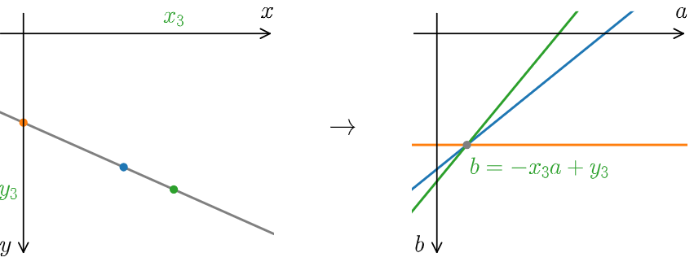
Hough Transform
Hough’s Idea
- In the spatial space (x,y), a line is parameterized by its coefficients a and b, giving the equation y=ax+b. Thus, any line can be identified by the pair (a,b).
- Hough's idea: each line of the image can be represented by a point in the Hough space (a,b). The Hough space is then called the parameter space.
Image Space
Parameter Space
Ref: https://vincmazet.github.io/bip/detection/lines.html

Slide 18
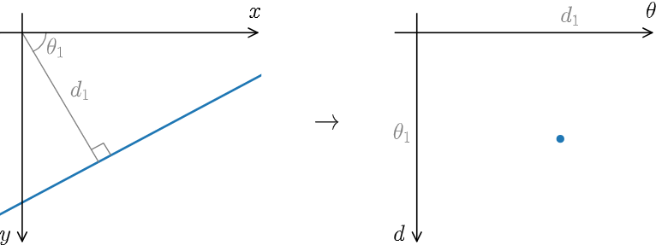
Hough Transform
Re-parameterization
The lines are defined from two other parameters:
- The distance d of the segment connecting the origin with the point closest to the line (this segment is perpendicular to the line).
- The angle θ of this segment with the x-axis.
Ref: https://vincmazet.github.io/bip/detection/lines.html

Slide 19
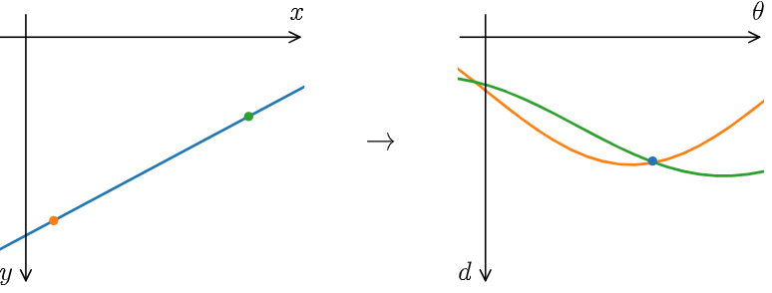
Hough Transform
Re-parameterization
- For each point (x_{i}, y_{i}) of the image, a sinusoid of equation d= x_{i}cos(θ)+ y_{i}sin(θ) is associated in the space (θ, d).
Ref: https://vincmazet.github.io/bip/detection/lines.html

Slide 20
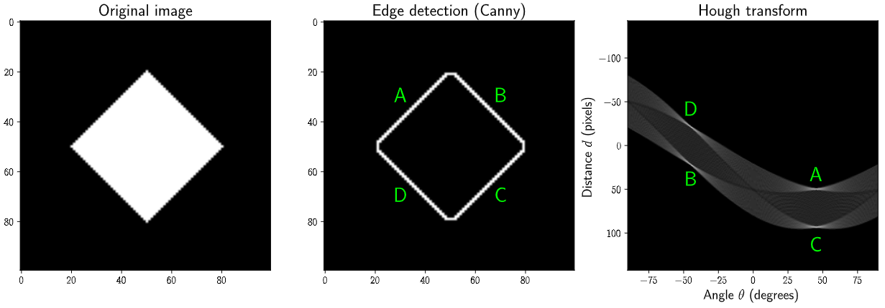
Hough Transform
Algorithm
- Compute an edge detection of the image.
- Initialize the accumulator (as the discrete space of the parameters).
- For each pixel in the edges, determine the sinusoid corresponding to the points.
- Search for the maxima in the accumulator: they correspond to the parameters of the lines in the image.
Ref: https://vincmazet.github.io/bip/detection/lines.html

Slide 21
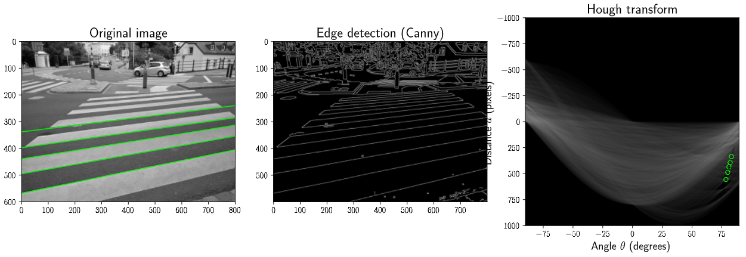
Hough Transform
Example
An example of a Hough transform on a real photograph.
Ref: https://vincmazet.github.io/bip/detection/lines.html

Slide 22
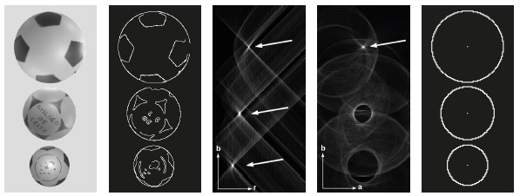
Hough Transform
Other Shapes
- Example: Circle detection
Ref: https://www.scielo.br/j/tema/a/FD5MHcLjMVpcZdJLVBmscBC/

Slide 23
Line Detection
Practice
- Hough Transform

Slide 24
Thank You
anhtl@ut.edu.vn

